Slide 1
Orthogonality and Least Squares
ORTHOGONAL PROJECTIONS

Slide 2
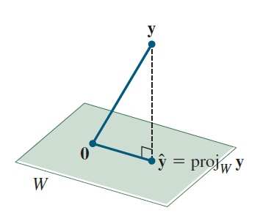
ORTHOGONAL PROJECTIONS
The orthogonal projection of a point in onto a line through the origin has an important analogue in .
Given a vector y and a subspace W in , there is a vector in W such that
is the unique vector in W for which
is orthogonal to W, and
is the unique vector in W
closest to y.

Slide 3
THE ORTHOGONAL DECOMPOSITION THEOREM
These two properties of provide the key to finding the least-squares solutions of linear systems.
Theorem 8: Let W be a subspace of . Then each y in can be written uniquely in the form
(1)
where is in W and z is in .
In fact, if {u₁,…,u_{p}} is any orthogonal basis of W, then
(2)
and .

Slide 4
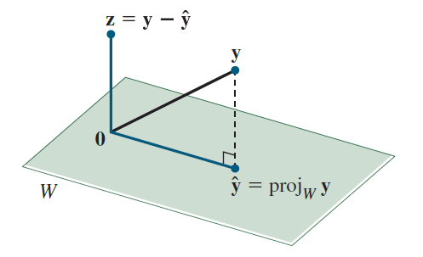

THE ORTHOGONAL DECOMPOSITION THEOREM
The vector in (1) is called the orthogonal projection of y onto W and often is written as proj_{W}y. See the following figure.
Proof: Let {u₁,…,u_{p}} be any orthogonal basis for W, and define by (2).
Then is in W because is a linear combination of the basis u₁,…,u_{p.}

Slide 5
THE ORTHOGONAL DECOMPOSITION THEOREM
Let .
Since u₁ is orthogonal to u₂,…,u_{p}, it follows from (2) that
Thus z is orthogonal to u₁.
Similarly, z is orthogonal to each u_{j} in the basis for W.
Hence z is orthogonal to every vector in W.
That is, z is in .

Slide 6
THE ORTHOGONAL DECOMPOSITION THEOREM
To show that the decomposition in (1) is unique, suppose y can also be written as , with in W and z₁ in .
Then (since both sides equal y), and so
This equality shows that the vector is in W and in (because z₁ and z are both in , and is a subspace).
Hence , which shows that .
This proves that and also .

Slide 7
THE ORTHOGONAL DECOMPOSITION THEOREM
The uniqueness of the decomposition (1) shows that the orthogonal projection depends only on W and not on the particular basis used in (2).
Example 1: Let .
Observe that {u₁, u₂} is an orthogonal basis for
. Write y as the sum of a vector in W and a vector orthogonal to W.

Slide 8
THE ORTHOGONAL DECOMPOSITION THEOREM
Solution: The orthogonal projection of y onto W is
Also

Slide 9
THE ORTHOGONAL DECOMPOSITION THEOREM
Theorem 8 ensures that is in .
To check the calculations, verify that is orthogonal to both u₁ and u₂ and hence to all of W.
The desired decomposition of y is

Slide 10
PROPERTIES OF ORTHOGONAL PROJECTIONS
If {u₁,…,u_{p}} is an orthogonal basis for W and if y happens to be in W, then the formula for proj_{W}y is exactly the same as the representation of y given in Theorem 5 in Section 6.2.
In this case, .
If y is in , then .

Slide 11
THE BEST APPROXIMATION THEOREM
Theorem 9: Let W be a subspace of , let y be any vector in , and let be the orthogonal projection of y onto W. Then is the closest point in W to y, in the sense that
(3)
for all v in W distinct from .
The vector in Theorem 9 is called the best approximation to y by elements of W.
The distance from y to v, given by , can be regarded as the “error” of using v in place of y.
Theorem 9 says that this error is minimized when .

Slide 12
THE BEST APPROXIMATION THEOREM
Inequality (3) leads to a new proof that does not depend on the particular orthogonal basis used to compute it.
If a different orthogonal basis for W were used to construct an orthogonal projection of y, then this projection would also be the closest point in W to y, namely, .

Slide 13
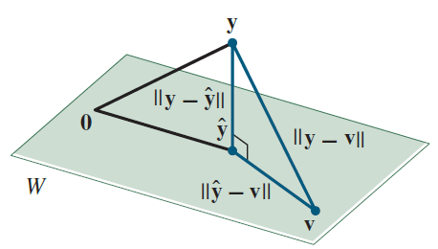
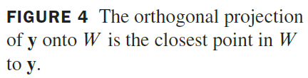
THE BEST APPROXIMATION THEOREM
Proof: Take v in W distinct from . See the following figure.
Then is in W.
By the Orthogonal Decomposition Theorem, is orthogonal to W.
In particular, is orthogonal to (which is in W ).

Slide 14
THE BEST APPROXIMATION THEOREM
Since
the Pythagorean Theorem gives
Now because , and so inequality
(3) follows immediately.

Slide 15
PROPERTIES OF ORTHOGONAL PROJECTIONS
Example 2: The distance from a point y in to a subspace W is defined as the distance from y to the nearest point in W. Find the distance from y to
, where
Solution: By the Best Approximation Theorem, the distance from y to W is , where .

Slide 16
PROPERTIES OF ORTHOGONAL PROJECTIONS
Since {u₁, u₂} is an orthogonal basis for W,
The distance from y to W is .

Slide 17
PROPERTIES OF ORTHOGONAL PROJECTIONS
Theorem 10: If {u₁,…,u_{p}} is an orthogonal basis for a subspace W of , then
(4)
If , then
for all y in (5)
Proof: Formula (4) follows immediately from (2) in Theorem 8.

Slide 18
PROPERTIES OF ORTHOGONAL PROJECTIONS
Also, (4) shows that proj_{W}y is a linear combination of the columns of U using the weights .
The weights can be written as , showing that they are the entries in U^{T}y and justifying (5).

